Slide 1
BCBSAZ Health Choice
Provider Satisfaction Survey

Slide 2
Provider Satisfaction Survey
The information is used by BCBSAZ Health Choice in quality improvement efforts and to provide rational direction to support those efforts.
This research is designed to:
  Measure overall provider satisfaction with BCBSAZ Health Choice.
  Measure satisfaction with specific elements of programs and services provided to physicians by BCBSAZ Health Choice.
  Identify ways for BCBSAZ Health Choice to improve their services to both members and providers.
  Identify how providers view managed care plans, in general, and BCBSAZ Health Choice specifically, as well as how they feel BCBSAZ Health Choice compares with other managed care plans.
  Compare results, in total, to those previously recorded, where possible, and by provider type.
  Evaluate and classify program and service elements on the basis of their importance to providers and perceived performance of BCBSAZ Health Choice (i.e., identify areas of strength and opportunities for improvement).

Slide 3
Provider Satisfaction Survey
Respondent file for BCBSAZ Health Choice

Slide 4
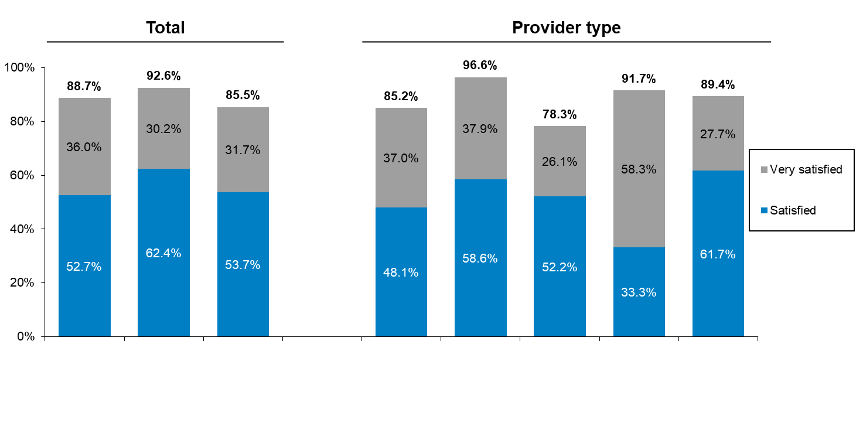
Provider Satisfaction Survey
Overall satisfaction with BCBSAZ Health Choice
(n=150) | (n=149) | (n=227) |  | (n=27) | (n=29) | (n=23) | (n=24) | (n=47)
2023 | 2022 | 2021 |  | PCP | Specialist | Dental | Ancillary | Other
 |  |  |  | (A) | (B) | (C) | (D) | (E)

